Slide 1
Autodesk® Network License Manager
Jimmy Bergmark
Owner of JTB World

Slide 2
Class Summary
In this class you learn how to manage network licenses. You will learn the steps required to install and configure Autodesk® Network License Manager and use the Options file to manage group license permissions. We will also cover command-line tools, how to troubleshoot and diagnose problems, optimization, limit borrowing, and upgrade licenses. You will learn how to list current users and create usage reports. This class will benefit everyone new to network licenses and those that want to learn more.

Slide 3
Learning Objectives
At the end of this class, you will be able to:
Install and configure Autodesk® Network License Manager
Manage network licenses
Troubleshoot network license issues
Report license usage

Slide 4
Installing and configure Autodesk® Network License Manager

Slide 5
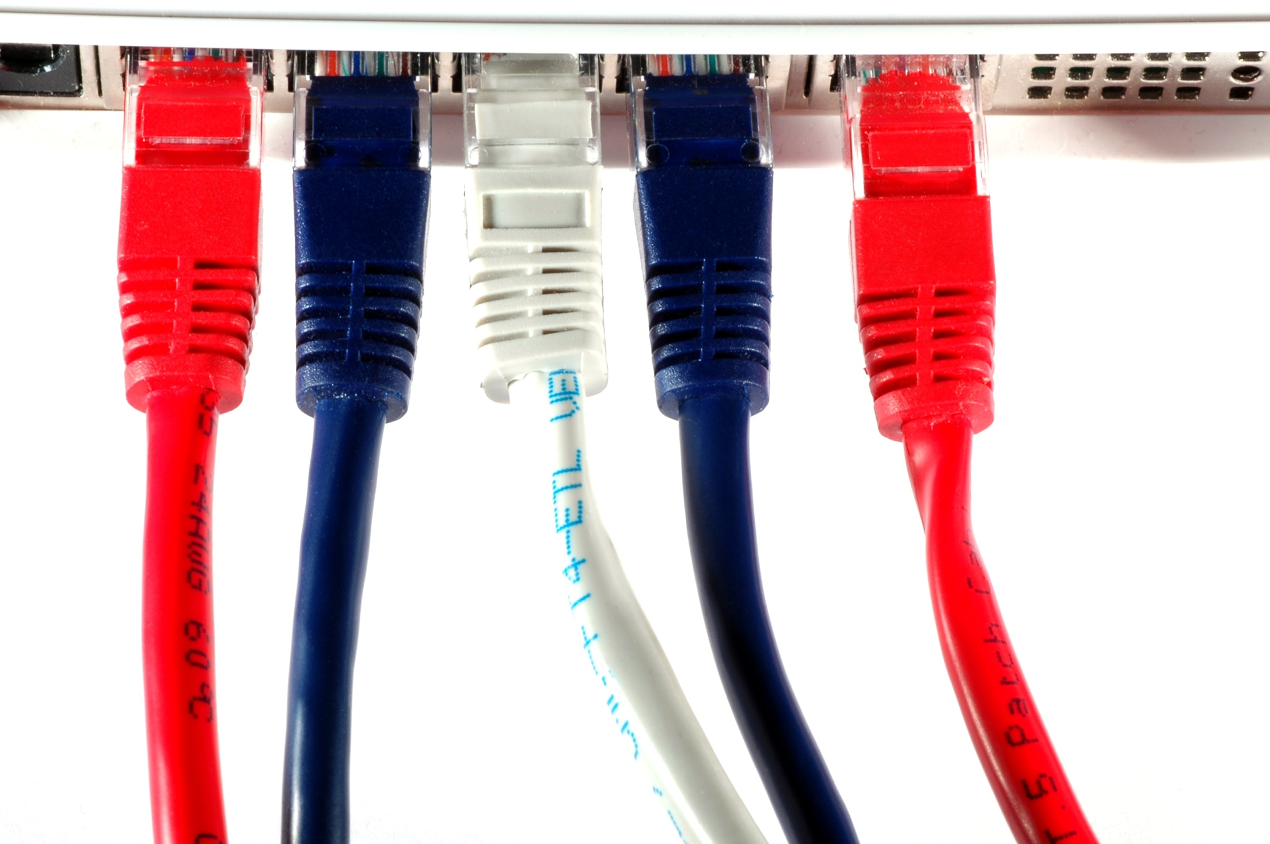
Network Licenses
Licenses shared within the network
Flexibility
Save on license fees

Slide 6
Deploying License Servers
Planning: determine type of setup
Single or Multiple servers
Standalone, Distributed or Redundant
Install License Manager
Obtain license file
Configure License Manager

Slide 7
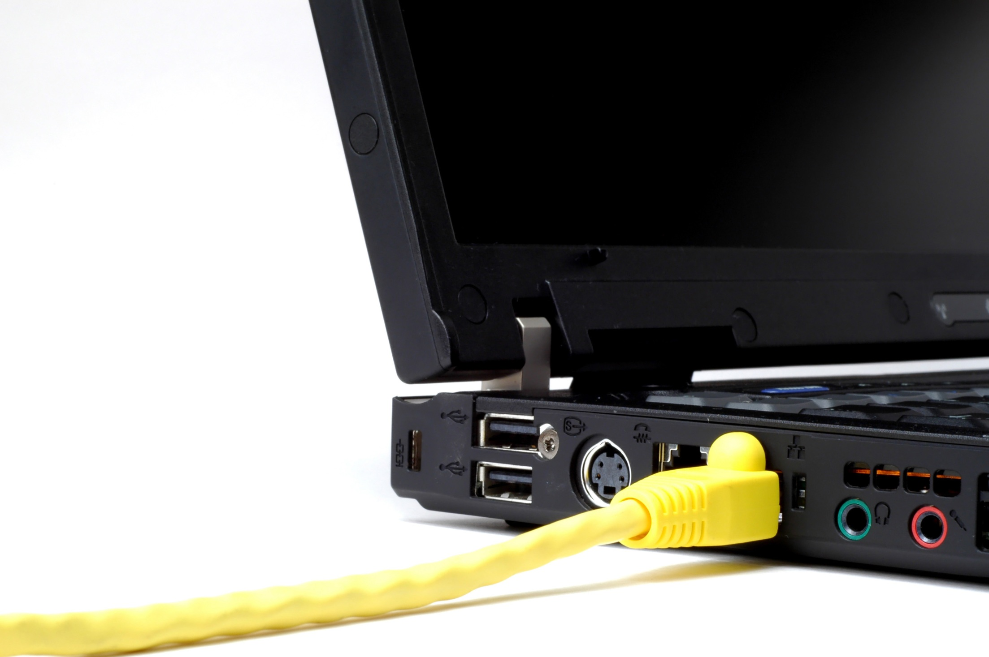
Planning
Single or Multiple servers?
Single, Distributed or Redundant (or a mix)

Slide 8
Single License Server
Simple
Single point of failure
Risky
PC
PC
Server
PC

Slide 9
Distributed License Servers
Flexible
Redundancy
WAN support
Infrastructure failure tolerant
PC
Server A
PC
Server B
PC

Slide 10
Redundant License Servers
Redundancy
Highest level of server fault tolerance
Intolerant of infrastructure failure
All servers on same subnet
Complex to administer
Server A
PC
PC
Server B
PC
Server C

Slide 11
Other Options
Global Network Use License (GNUL)
MultiFlex
Internet

Slide 12
System Requirements
Windows, Linux and MacOS X supported
Low requirements
Ethernet network configurations only
Virtual Machines

Slide 13
Installation
Start Autodesk® Product Installer
Click Install Tools & Utilities

Slide 14
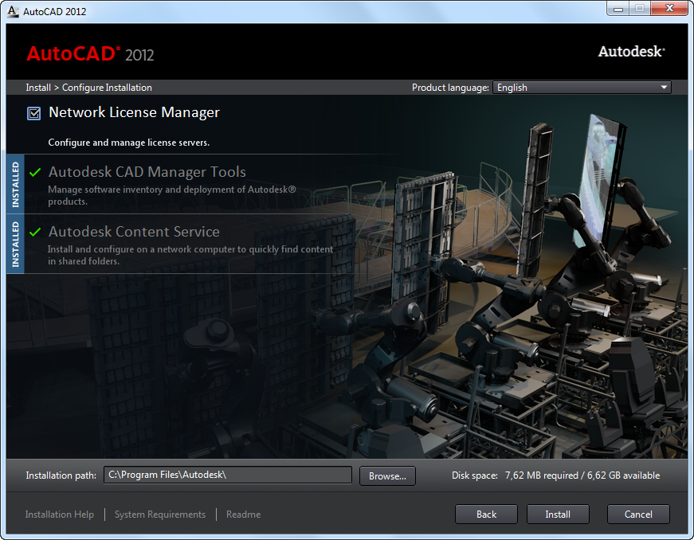
Installation
Select Network License Manager
Install

Slide 15
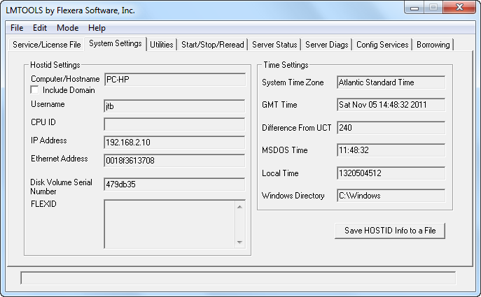
How to Request a License File
Server host name
Host ID / MAC address / Ethernet Address
Product serial number
Name and version of each product
Quantity of licenses for each product/version per license server
Server setup (Single, Redundant or Distributed)

Slide 16
License file
SERVER ALPHA 0328f1613717 27000
USE_SERVER
VENDOR adskflex port=2080
PACKAGE 64300ACD_F adskflex 3.000 COMPONENTS="85536ACD_2011_0F \
71200ACD_2010_0F 57600ACD_2009_0F 54600ACD_2008_0F" \
OPTIONS=SUITE SUPERSEDE ISSUED=06-May-2010 SIGN="0BE5 1EFE \
AA6C 4934 9C5D CC83 92F5 8062 9794 45E5 1F61 7396 BE23 B21A \
1CE6 02F1 A207 387E D5A4 5CC0 2F96 4F91 F1AC BAC4 3F82 6BB3 \
0153 6783 296C D8CC" SIGN2="17EC 7275 EAAD C6EC C3DE E23E 0259 \
7468 91A0 7992 C01D 76C7 D9CF 790E 2087 0269 46B0 1F53 DF88 \
A1EF ECB5 6B19 DEE7 53D4 8A84 DCD5 7A3D 04E4 9B23 356B"
INCREMENT 64300ACD_F adskflex 3.000 permanent 2 \
VENDOR_STRING=nfr:permanent SUPERSEDE DUP_GROUP=UH \
SUITE_DUP_GROUP=UHV ISSUED=06-May-2010 BORROW=4320 \
SN=400-12345678 SIGN="03AB 970D 4C77 464A A3E9 7D3B 2511 6DCA \
F490 8211 0548 470C 041F C0F2 7660 013E 00DE EFDC E8C6 7B2B \
C5A7 1853 1FB7 A056 7A98 D176 170B 2020 8F0B C871" SIGN2="0CED \
A29B 2FF9 AE62 1E8F 8C8C 8E5D ABF1 0BE1 B116 F89C C8A3 21A1 \
39E4 A31D 0589 3206 D84E BE68 DD7B EB34 E29F 36D3 5890 80F3 \
6DD7 6425 98DC E8A4 7BCC“
INCREMENT PLIST adskflex 3.000 permanent 1 \
VENDOR_STRING=A07:51600ACDLAND_2007_0F:52200CIV3D_2007_0F;B07:51900AMECH_PP_2007_0F:51300INVBUN_11_0F:52900INVPRORS_11_0F:53000INVPROSIM_11_0F:51400INVPRO_11_0F;C07:51200ACD_2007_0F:52500REVITS_9_0F:54100REVITS_9_1F:53700REVSU_3_0F:54200REVSU_4_0F;D07:52600REVIT_9_0F:52500REVITS_9_0F;E07:57600ACD_2009_0P:59300INVBUN_2009_0P;F07:51800BLDSYS_2007_0F:53100REVSYP_1_0F:54500REVSYP_2_0F;G07:53400REVITST_3_0F:53700REVSU_3_0F;H07:54300REVIT_9_1F:54100REVITS_9_1F;I07:54400REVITST_4_0F:54200REVSU_4_0F;A08:55500ACDLAND_2008_0F:55400CIV3D_2008_0F;B08:54900AMECH_PP_2008_0F:55000INVBUN_2008_0F:55100INVPRORS_2008_0F:55200INVPROSIM_2008_0F:55300INVPRO_2008_0F;C08:54600ACD_2008_0F:54700REVITS_2008_0F:54800REVSU_2008_0F;D08:57100REVIT_2008_0F:54700REVITS_2008_0F;F08:55600BLDSYS_2008_0F:55700REVSYP_2008_0F;G08:57200REVITST_2008_0F:54800REVSU_2008_0F;A09:59800ACDLAND_2009_0F:59700CIV3D_2009_0F;B09:59200AMECH_PP_2009_0F:59300INVBUN_2009_0F:59400INVPRORS_2009_0F:61700INVMFG_2009_0F:59500INVPROSIM_2009_0F:59600INVPRO_2009_0F;C09:57600ACD_2009_0F:59200AMECH_PP_2009_0F:78400ACDDS_2009_0F:60900REVITS_2009_0F:61000REVSU_2009_0F;D09:62100REVIT_2009_0F:60900REVITS_2009_0F:78200RAV-S_2009_0F;F09:59900BLDSYS_2009_0F:60000REVSYP_2009_0F;G09:62200REVITST_2009_0F:61000REVSU_2009_0F;J09:67800RVTMPJ_2009_0F:60000REVSYP_2009_0F;K09:68800CIVIL_2009_0F:59700CIV3D_2009_0F;L09:60100ARCHDESK_2009_0F:60900REVITS_2009_0F:78200RAV-S_2009_0F;M09:68900NAVREV_2009_1F:78200RAV-S_2009_0F \
SUPERSEDE ISSUED=06-May-2010 SIGN="142D 251E 421E AE1F 357B \
A06E C753 B580 2ED6 5DF9 4E6C 803F 6E7A C39C C330 19E0 BCCB \
C92D D9CD CC92 6A30 F1DC F3EC 00E4 C7A3 ABF5 F33D 4B38 925A \
DD26" SIGN2="001D A887 DC16 D2ED AB45 400B AB41 E051 73C4 DB42 \
AF01 2098 706B CBA1 C0FD 0C2B 414D CC30 7CE1 44CD AD76 0DFC \
2146 9034 E7AD 70C2 E7D4 69A2 A1CC 6AA3"
Server Host Name
Host ID (MAC address)
Product Serial Number
Name and version of each product
Quantity of licenses
Type of server setup

Slide 17
Configure the License Server

Slide 18
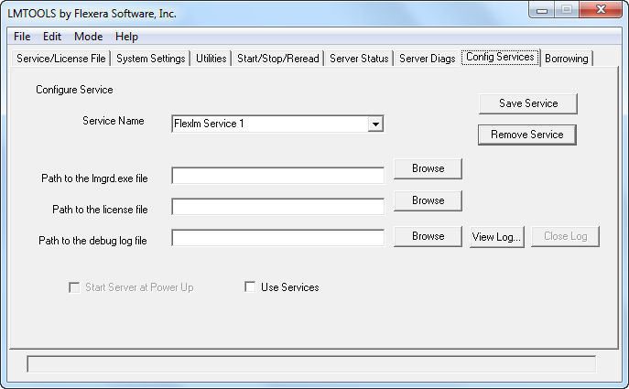
Configure the License Server

Slide 19
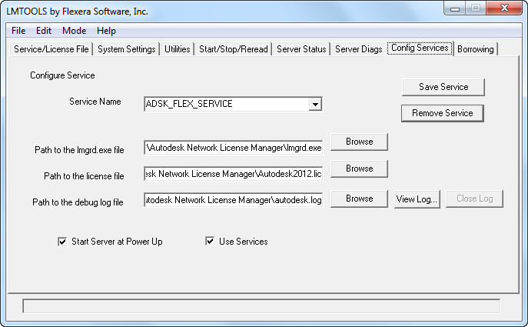
Configure the License Server

Slide 20
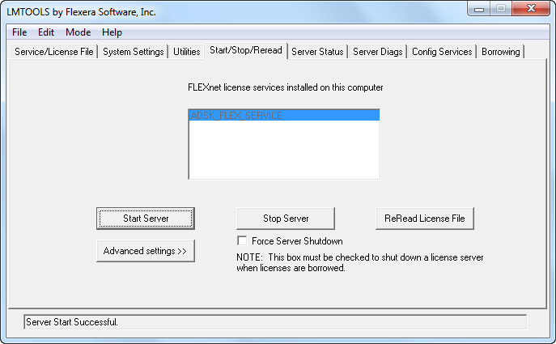
Configure the License Server

Slide 21
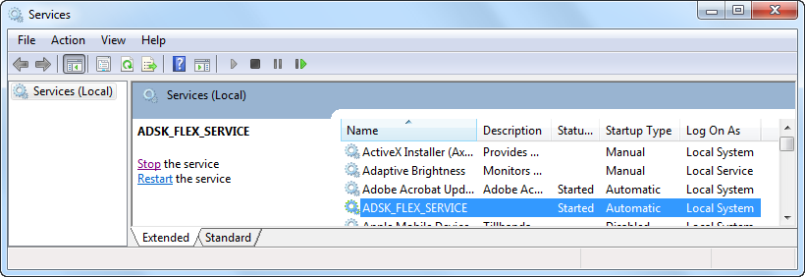
Configure the License Server

Slide 22
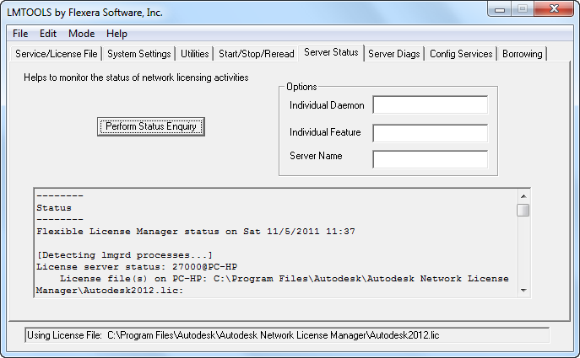
Configure the License Server

Slide 23
Managing network licenses

Slide 24
FlexNet License Server
License Manager Tools
(lmtools.exe)
Command-Line Utilities
(lmutil.exe)
PC
PC
Server
License File
FlexNet Debug Log
License Server Manager
(lmgrd.exe)
PC
Options File
(adskflex.opt)
Vendor Daemon from Autodesk®
(adskflex.exe)
Report Log
(.rl)

Slide 25
LMTOOLS

Slide 26
Update FlexNet from a Previous Version
lmgrd.exe, lmtools.exe, lmutil.exe and adskflex.exe
Stop Server using LMTOOLS
Uninstall
Install
Alternatively replace the exe files

Slide 27
Set Up and Use an Options File
File Name: adskflex.opt
Not required, optional
License timeout
License borrowing
Report log file
Reserving license usage
Restricting license usage
Defining groups of users or hosts

Slide 28
License Timeout
TIMEOUT Autodesk_f1 900
TIMEOUTALL 900
Minimum 900 seconds

Slide 29
License Timeout
Any keystroke
Any mouse click
Any command, Lisp expression, menu macro or script in progress
Automatic save
Any Modal dialog box opened

Slide 30
Groups of Users or Computers
Use GROUPCASEINSENSITIVE ON
GROUP EngineeringGroup userA userB userC
HOST_GROUP DraftingDept computer1 computer2 computer3

Slide 31
License Borrowing
Maximum borrow period 6 months
Limiting borrowing: BORROW_LOWWATER Autodesk_f1 5
Limit borrow period: MAX_BORROW_HOURS Autodesk_f1 72
Excluding license borrowing: EXCLUDE_BORROW Autodesk_f1 USER john
Including license borrowing: INCLUDE_BORROW Autodesk_f1 USER john

Slide 32
Reserve network licenses
The following examples reserve either 1 or 5 AutoCAD® 2012 licenses for a variety of types:
RESERVE 1 85730ACD_2012_0F USER smithj
RESERVE 1 85730ACD_2012_0F HOST computer1
RESERVE 5 85730ACD_2012_0F GROUP EngineeringGroup
RESERVE 5 85730ACD_2012_0F HOST_GROUP DraftingDept
RESERVE 1 85730ACD_2012_0F INTERNET 192.168.0.100
RESERVE 5 85730ACD_2012_0F INTERNET 192.168.0.*
RESERVE 5 85730ACD_2012_0F PROJECT CivilProject

Slide 33
Restrict maximum license usage
The following examples set a limit of either 1 or 5 AutoCAD® 2012 licenses for a variety of types:
MAX 1 85730ACD_2012_0F USER smithj
MAX 1 85730ACD_2012_0F HOST computer1
MAX 5 85730ACD_2012_0F GROUP EngineeringGroup
MAX 5 85730ACD_2012_0F HOST_GROUP DraftingDept
MAX 1 85730ACD_2012_0F INTERNET 192.168.0.100
MAX 5 85730ACD_2012_0F INTERNET 192.168.0.*
MAX 5 85730ACD_2012_0F PROJECT CivilProject

Slide 34
Excluding license usage
The following examples block access to AutoCAD® 2012 licenses for a variety of types:
EXCLUDE 85730ACD_2012_0F USER smithj
EXCLUDE 85730ACD_2012_0F HOST computer1
EXCLUDE 85730ACD_2012_0F GROUP EngineeringGroup
EXCLUDE 85730ACD_2012_0F HOST_GROUP DraftingDept
EXCLUDE 85730ACD_2012_0F INTERNET 192.168.0.100
EXCLUDE 85730ACD_2012_0F INTERNET 192.168.0.*
EXCLUDE 85730ACD_2012_0F PROJECT CivilProject

Slide 35
Including license usage
The following examples provide access to AutoCAD® 2012 licenses for the specified type only:
INCLUDE 85730ACD_2012_0F USER smithj
INCLUDE 85730ACD_2012_0F HOST computer1
INCLUDE 85730ACD_2012_0F GROUP EngineeringGroup
INCLUDE 85730ACD_2012_0F HOST_GROUP DraftingDept
INCLUDE 85730ACD_2012_0F INTERNET 192.168.0.100
INCLUDE 85730ACD_2012_0F INTERNET 192.168.0.*
INCLUDE 85730ACD_2012_0F PROJECT CivilProject

Slide 36
Sample Options File
# Comment rows are starting with #
TIMEOUTALL 900
GROUPCASEINSENSITIVE ON
GROUP Drafters pete john emma HOST_GROUP DraftingDept computer1 computer2 computer3
BORROW_LOWWATER 85730ACD_2012_0F 5
MAX_BORROW_HOURS 85730ACD_2012_0F 240 EXCLUDE_BORROW 85730ACD_2012_0F USER smithj INCLUDE_BORROW 85730ACD_2012_0F GROUP Drafters RESERVE 1 85730ACD_2012_0F HOST computer1
MAX 5 85730ACD_2012_0F HOST_GROUP DraftingDept
EXCLUDE 85730ACD_2012_0F PROJECT CivilProject INCLUDE 85730ACD_2012_0F INTERNET 192.168.0.*
REPORTLOG +"C:\Reports\MyServer.rl“

Slide 37
Network License File
SERVER MyLicenseServer 0019bbd68993 port=27003 USE_SERVER VENDOR adskflex port=2080 INCREMENT 57600ACD_2009_0F adskflex 1.000 permanent 5 \ VENDOR_STRING=commercial:permanent BORROW=4320 SUPERSEDE \ DUP_GROUP=UH ISSUED=09-Jan-2008 SN=123-12345678 SIGN="1393 \ E368 816E D417 C1CD 7DBD 7B90 1354 D6F0 48FE EBB8 9C84 C3AF \ 7D79 BEE1 0181 0655 76FF 996C B707 14B5 D4DE A3FE 0B2D 2D36 \ 057C A579 7866 26BF 44E2" SIGN2="1280 943B 53A7 9B93 E00B D967 \ D821 BD37 BE6D B78A F074 B223 88AA 242C DD0A 1292 D56F 4108 \ 62CD FA35 E365 0736 A011 7833 8B35 7BFF DAD8 34A8 452F 2EB4"

Slide 38
Package License
SERVER Server1 1a34567c90d2 USE_SERVER VENDOR adskflex port=2080 PACKAGE SERIES_1 adskflex 1.000 COMPONENTS="54700REVIT_2009_0F \ 54600ACD_2009_0F 51300INVBUN_11_0F" OPTIONS=SUITE SUPERSEDE \ ISSUED=09-Jan-2008 SIGN="1707 9EAC CBCB 2405 692E 4A89 \ AA26 30CC 2AC2 D6B3 A61B AB5E 492E 3EBD 0B48 4E75 193A DA82" \ FC45 C009 E360 944A 14BA E99C 9B24 5A1B 4A44 083A BE5F 3827 \ SIGN2="004A FC90 AB47 3F6B 59BC 0E6D 6681 6971 A76A BA52 98E2 \ 5671 26B3 0E78 791B 109F 0591 7DC3 F09F 4D8D 4FB7 E341 4A03 \ CD68 1D77 27F8 8555 9CF7 DEDD 9380" INCREMENT SERIES_1 adskflex 1.000 permanent 100 \ VENDOR_STRING=commercial:permanent BORROW=4320 DUP_GROUP=UH \ SUITE_DUP_GROUP=UHV SN=123-12345678 SIGN="1707 9EAC CBCB \ 692E 4A89 FC45 C009 E360 944A 14BA E99C 9B24 5A1B 4A44 BE5F \ 3827 AA26 30CC 2AC2 D6B3 A61B AB5E 492E 3EBD 0B48 DA82" \ SIGN2="004A FC90 AB47 3F6B 59BC 0E6D 6681 6971 A76A BA52 \ 5671 26B3 0E78 791B 109F 0591 7DC3 F09F 4D8D 4FB7 E341 4A03 \ CD68 1D77 27F8 8555 9CF7 DEDD 9380"

Slide 39
Combining network license files
SERVER servername 123456789111
USE_SERVER
VENDOR adskflex port=2080
PACKAGE 64300ACD_F adskflex 1.000 COMPONENTS="57600ACD_2009_0F \
54600ACD_2008_0F 85730ACD_2012_0F 64300ACD_F" \
OPTIONS=SUITE SUPERSEDE ISSUED=25-Jun-2008 SIGN="03EF … 7240"
INCREMENT 64300ACD_F adskflex 1.000 permanent 2 \
VENDOR_STRING=commercial:permanent BORROW=4320 SUPERSEDE \
DUP_GROUP=UH SUITE_DUP_GROUP=UHV ISSUED=25-Jun-2008 \
SN=399-99999999 SIGN="1CCB E88D B819 8604 06FA … 1644"
PACKAGE 64800INVPRO_F adskflex 1.000 \
COMPONENTS="59600INVPRO_2009_0F \
55300INVPRO_2008_0F 51400INVPRO_11_0F 49000INVPRO_10_0F" \
OPTIONS=SUITE SUPERSEDE ISSUED=25-Jun-2008 SIGN="1306 … 27F6"
INCREMENT 64800INVPRO_F adskflex 1.000 permanent 2 \
VENDOR_STRING=commercial:permanent BORROW=4320 SUPERSEDE \
DUP_GROUP=UH SUITE_DUP_GROUP=UHV ISSUED=25-Jun-2008 \
SN=399-99999966 SIGN="0BE4 51F4 570C … 5DA4"

Slide 40
Troubleshooting network license issues

Slide 41
Windows Services Console and Task Manager

Slide 42
Network License Manager startup
These steps are taken when LMGRD starts.
LMGRD writes to the debug log
Reads the license file
Starts the vendor daemon (ADSKFLEX)
ADSKFLEX writes to the debug log file
Reads the license file
Reads option file (if found)
Writes report log (if configured)

Slide 43
Application startup
These steps are taken when an application starts.
Application is executed
Application generates a request for a license
Server resolution occurs
LMGRD receives request
LMGRD determines the appropriate Vendor Daemon
Request is passed to Vendor Daemon (ADSKFLEX)
ADSKFLEX grant or denies a license
ADSKFLEX maintains a hearbeat with each active application session

Slide 44
FlexNet debug log
FlexNet Version
License Check Out and In
11:41:26 (lmgrd) FLEXnet Licensing (v11.9.0.0 build 87342 x64_n6) started on PC-HP (IBM PC) (11/5/2011)
11:41:26 (lmgrd) Copyright (c) 1988-2010 Flexera Software, Inc. All Rights Reserved.
11:41:26 (lmgrd) US Patents 5,390,297 and 5,671,412.
11:41:26 (lmgrd) World Wide Web: http://www.flexerasoftware.com
11:41:26 (lmgrd) License file(s): C:\Program Files\Autodesk\Autodesk Network License Manager\Autodesk2012.lic
11:41:26 (lmgrd) lmgrd tcp-port 27000
11:41:26 (lmgrd) Starting vendor daemons ...
11:41:26 (lmgrd) Starting vendor daemon at port 2080
11:41:26 (lmgrd) Using vendor daemon port 2080 specified in license file
11:41:26 (lmgrd) Started adskflex (pid 4292)
11:41:26 (adskflex) Unable to initialize access to trusted storage: 1
11:41:26 (adskflex) FLEXnet Licensing version v11.9.0.3 build 90785 x64_n6
11:41:27 (adskflex) Using options file: "C:\Program Files\Autodesk\Autodesk Network License Manager\adskflex.opt"
11:41:28 (adskflex) Server started on PC-HP for:
11:41:28 (adskflex) 64300ACD_F (consisting of: 85730ACD_2012_0F
11:41:28 (adskflex) 85536ACD_2011_0F 71200ACD_2010_0F 57600ACD_2009_0F)
11:41:28 (adskflex) PLIST
11:41:28 (adskflex) Report log started (+C:\Program Files\Autodesk Network License Manager\report.rl).
11:41:28 (adskflex) RESERVING 1 64300ACD_F/1D7A F565 91F7 9F30 license for USER tester
11:52:50 (adskflex) OUT: "64300ACD_F" jtb@PC-HP
11:52:50 (adskflex) OUT: "85730ACD_2012_0F" jtb@PC-HP
11:53:35 (adskflex) IN: "85730ACD_2012_0F" jtb@PC-HP
11:53:35 (adskflex) IN: "64300ACD_F" jtb@PC-HP
12:12:18 (adskflex) Rereading options file...
12:12:18 (adskflex) ALL FEATURES: INACTIVITY TIMEOUT set to 900 seconds
12:12:18 (adskflex) ...Finished rereading
11:55:02 (lmgrd) Rereading license file... Requested from jtb@PC-HP
11:55:02 (adskflex) 11:55:02 (lmgrd) file...
Done rereading
11:55:02 (lmgrd) ...Finished rereading
11:57:48 (adskflex) REMOVING jtb@PC-HP:PC-HP from 85730ACD_2012_0F by administrator request.
11:57:48 (adskflex) IN: "85730ACD_2012_0F" jtb@PC-HP (USER_REMOVED)
11:57:48 (adskflex) IN: "64300ACD_F" jtb@PC-HP (USER_REMOVED)
11:57:52 (adskflex) OUT: "64300ACD_F" jtb@PC-HP
11:57:52 (adskflex) OUT: "85730ACD_2012_0F" jtb@PC-HP
12:24:51 (adskflex) IN: "85730ACD_2012_0F " jtb@PC-HP (INACTIVE)
12:32:37 (adskflex) DENIED: "85730ACD_2012_0F " jtb@PC-HP (Licensed number of users already reached. (-4,342))
14:56:21 (adskflex) DENIED: "85730ACD_2012_0F " jtb@PC-HP (User/host not on INCLUDE list for feature. (-39,349))
License File
Rereading Options File
FlexNet daemon port
Borrowed License Returned Earlier
Vendor daemon port
Options File
Licensed features
Denied License Requests
Options records

Slide 45
Perform Status Enquiry
LMTOOLS
LMUTIL lmstat
Row showing the number of issued and in use licenses for a feature
Users of 85730ACD_2012_0F: (Total of 1 license issued; Total of 1 license in use)
Row showing a license that is in use
jtb PC-HP PC-HP (v4.000) (PC-HP/27000 301), start Sat 11/5 13:40
Row showing a borrowed license.
jtb PC-HP PC-HP (v1.0) (PC-HP/27000 101), start Sat 11/5 12:36 (linger: 40980)
Row showing a reserved license.
1 RESERVATION for HOST tester (PC-HP/27000)

Slide 46
Increasing verbosity
Server: lmutil.exe –verbose
Client: FLEXLM_DIAGNOSTICS environment variable

Slide 47
License not released after exiting product
Use TIMEOUT or TIMEOUTALL
LMUTIL.EXE LMREMOVE

Slide 48
FLEXLM_TIMEOUT
A valid license could not be obtained by the network license manager.
Error [1.5.-15]
VPN, dial-up or a slow DSL/ISDN link
FLEXLM_TIMEOUT Environment Variable

Slide 49
NIC Failure Recovery
Move NIC to replacement hardware
Edit the server name in license file if needed

Slide 50
Autodesk® Product Support and Knowledge Base
Product Support page: www.autodesk.com/support
To find a specific document use http://usa.autodesk.com/getdoc/id=TS1056448 where TS105644 is the document ID Or search the web for it

Slide 51
Reporting license usage

Slide 52
Using LMTOOLS

Slide 53
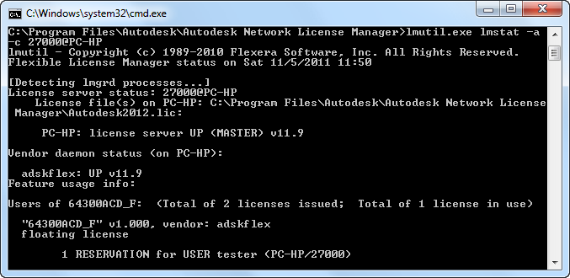
Using LMUTIL

Slide 54
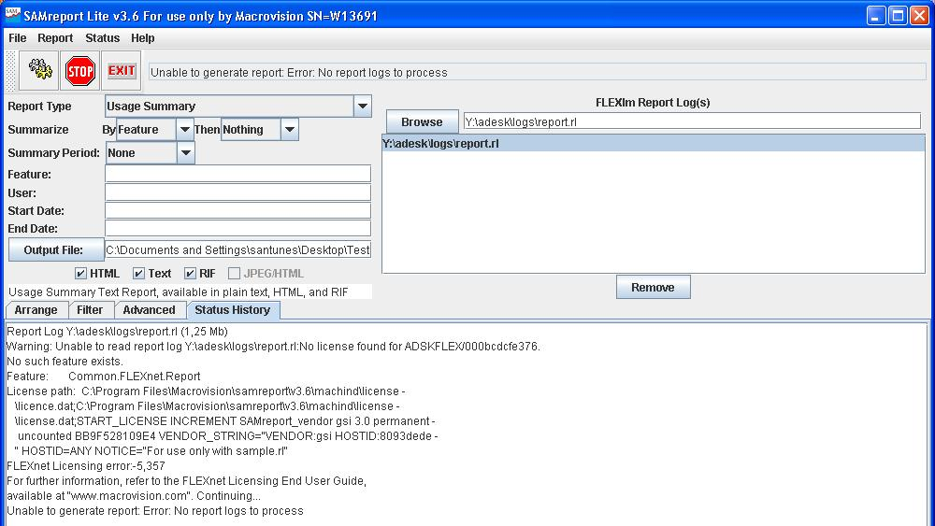
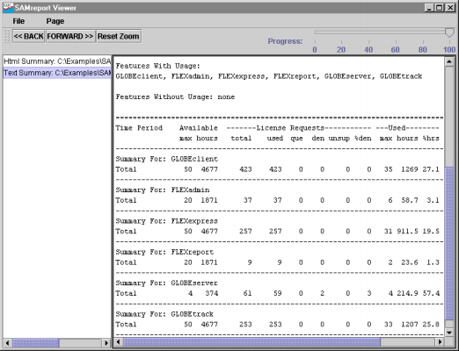
SAMreport-Lite

Slide 55
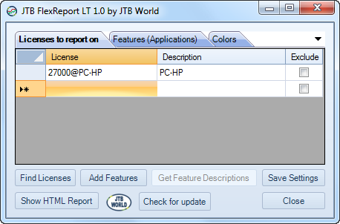
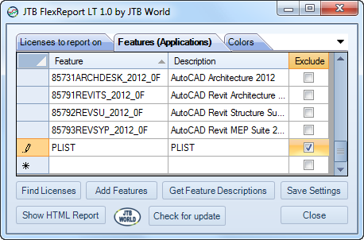
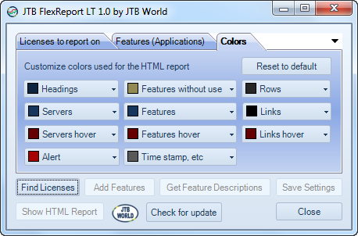
JTB FlexReport LT

Slide 56
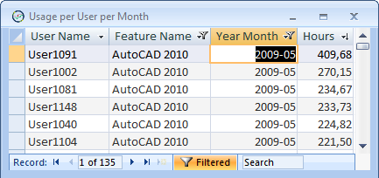
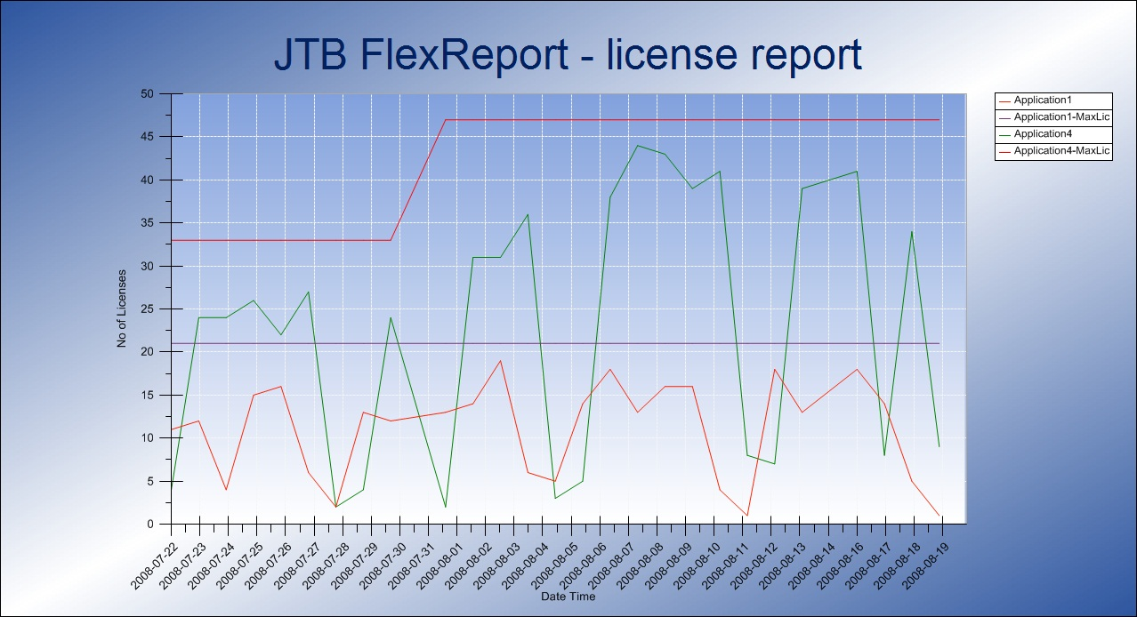
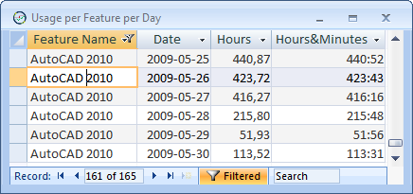
JTB FlexReport

Slide 57
Use TIMEOUT/TIMEOUTALL

Slide 58
References and resources
Autodesk® Product Support: www.autodesk.com/support
Installation & Licensing Discussion Group: http://forums.autodesk.com/t5/Installation-Licensing/bd-p/24
Up and Ready Blog by Autodesk: http://upandready.typepad.com
License File Parser: www.licenseparser.com
Network Administrator’s Bible by David M. Stein available on Amazon.com
JTB World: www.jtbworld.com and http://blog.jtbworld.com

Slide 59
Class Summary
By now you should be able to install and configure Autodesk® Network License Manager, manage the licenses, troubleshoot issues and report on license usage.
Feel free to contact me with any licensing questions.
Thanks for your time!
Jimmy Bergmark - JTB World
jimmy@jtbworld.com www.jtbworld.com
JTB
WORLD

Slide 60
Autodesk, AutoCAD* [*if/when mentioned in the pertinent material, followed by an alphabetical list of all other trademarks mentioned in the material] are registered trademarks or trademarks of Autodesk, Inc., and/or its subsidiaries and/or affiliates in the USA and/or other countries. All other brand names, product names, or trademarks belong to their respective holders. Autodesk reserves the right to alter product and services offerings, and specifications and pricing at any time without notice, and is not responsible for typographical or graphical errors that may appear in this document. © 2011 Autodesk, Inc. All rights reserved.

